Slide 1
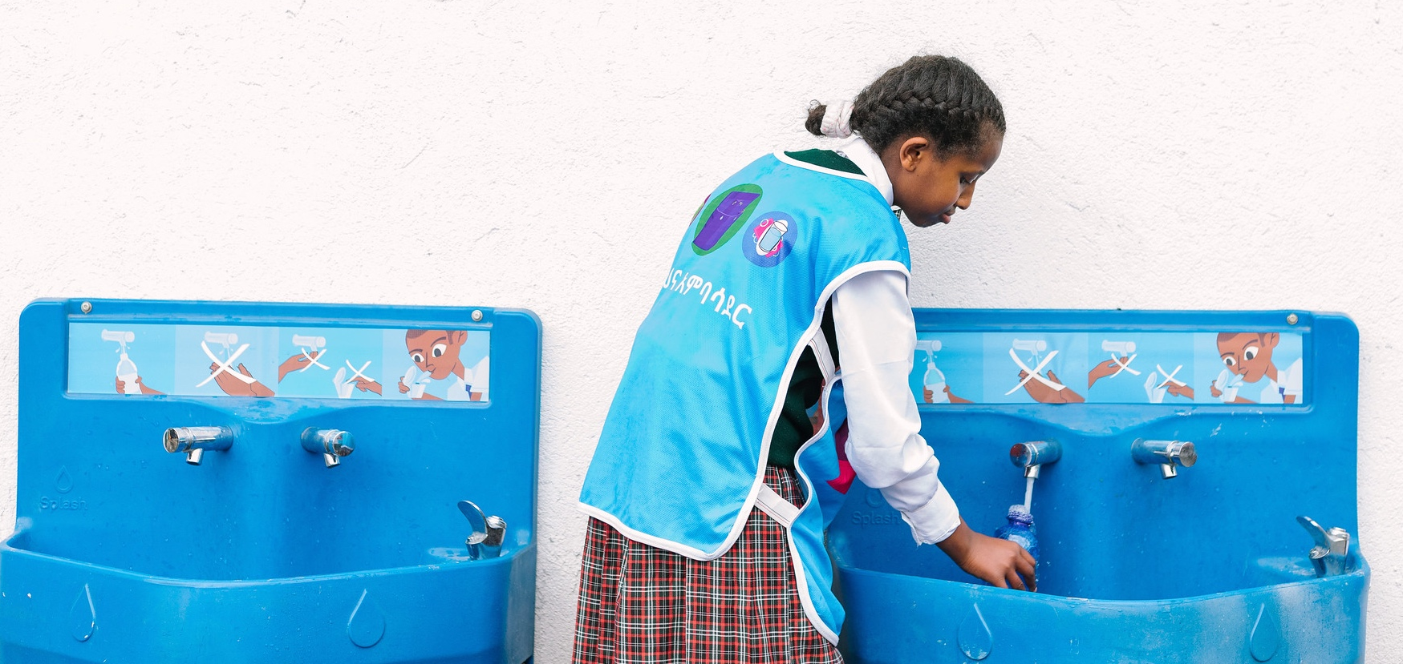
Splash
We Clean Water For Kids
Notes:
Speaker: Eric
Speaker notes:
Welcome, everyone to the Year 4 Project WISE APR. It’s been a busy and productive last year.
In this APR we want to highlight all of the things CIFF should be proud of, while also acknowledging the challenges. These range from big picture issues like the pandemic, inflation, political insecurity, and water availability to smaller but critical problems like tap breakage and vandalism.
First and foremost, I just want you all to know how much we value CIFF as a partner and how much we appreciate that you are here today.

Slide 2
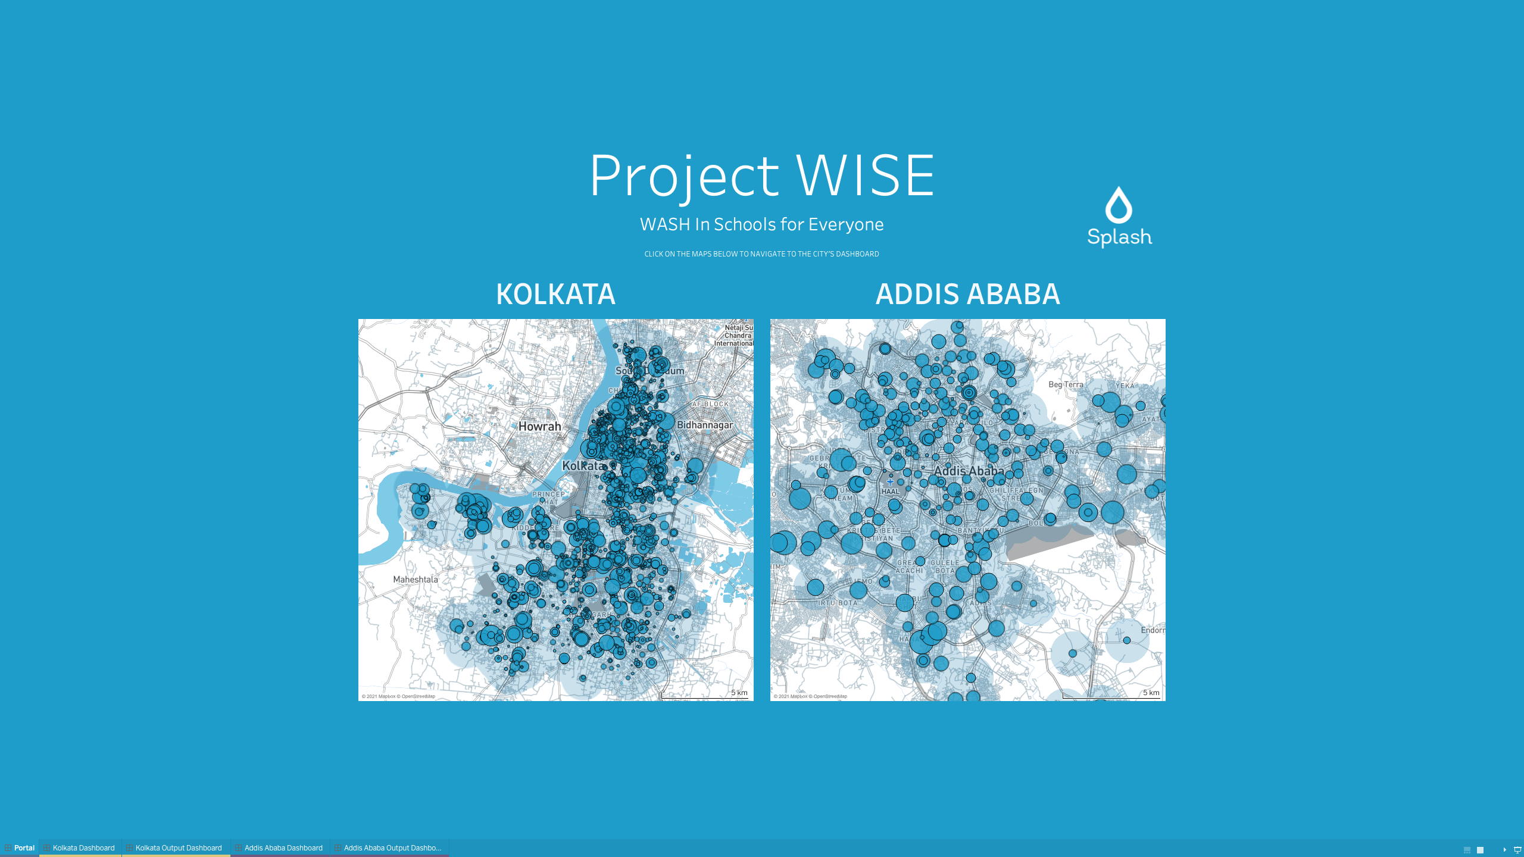
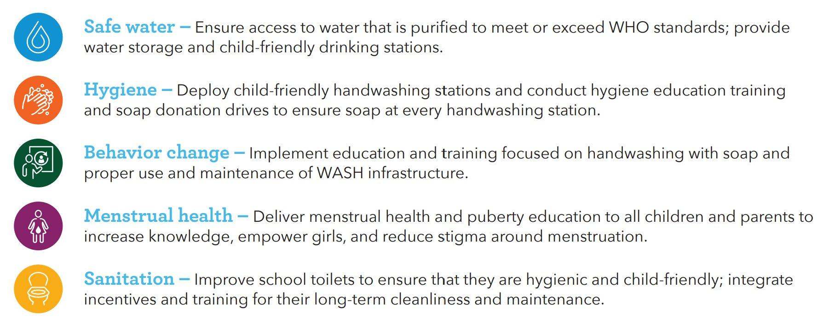
SCHOOL-CENTERED, CITYWIDE SCALE
Splash’s WASH solution is based on a simple fact: There is no faster way to reach the highest concentration of poor urban children than through city schools. Our WASH in Schools approach has five cascading components.
But we don’t just do this at a few schools. We do this at hundreds of schools, reaching full coverage to ensure sustainability and so other cities can see, learn, and copy.
2
Notes:
Eric

Slide 3




Project WISE Overview
KEY METRICS
Better health and school attendance through water, sanitation, hygiene, and menstrual health (WASH-M) in schools
GEOGRAPHY
Addis Ababa, Ethiopia
Bahir Dar, Ethiopia
Kolkata, India
2
COUNTRIES
3
CITIES
898
SCHOOLS
854,000
STUDENTS & STAFF BENEFITTED
TRANSFORMATIVE PROPOSITION
Splash is transforming WASH conditions at public schools across three cities in Ethiopia and India — serving more than 800,000 children and providing an affordable, proven, and replicable model for national coverage of all schools for all students. Working in kindergarten, primary, and secondary schools, this project provides improved water, sanitation, and hygiene infrastructure; behavior change programs for kids and adults; and strengthened menstrual health services for girls aged 10 and above.
3
Notes:
Eric

Slide 4
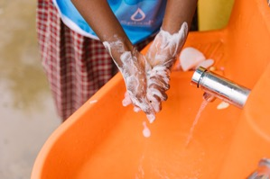
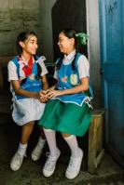
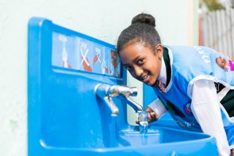
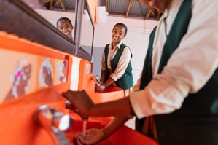
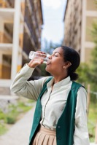
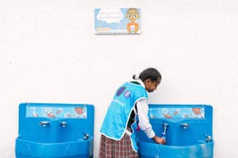
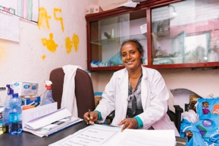
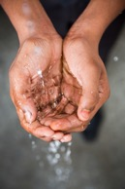
Our Impacts to date
The London School of Hygiene and Tropical Medicine found a
17% reduction in respiratory illness
at Splash intervention schools attributed to Splash’s WASH in Schools program.
3% increase in
girls’ self-efficacy
33% reduction in
KG absences
22% increase in observed handwashing
Lower rates of diarrheal disease & absences
The study found a small but statistically significant increase in menstrual hygiene self-efficacy of
3.4 points on a 0-100 scale.
The study found a statistically significant 33% reduction in care-giver reported absence in the KG study.
58% of students in Addis and 70% in Kolkata wash their hands with soap – a 22% increase since project began.
There were significantly lower rates of both diarrheal disease and school absences at baseline among both groups - making it harder to see impacts.
4
Notes:
Speaker: Chris
Speaker notes:
Mention findings from the process evaluation – there have been some findings in the process evaluation that raised questions among the group, but there were recently some updates on those and clarity provided by LSHTM. I am happy to address any remaining questions in the question/answer session.
Additionally, we are in the midst of finishing up some interesting research on HH ripple effects of Splash’s work on the household as well as a deeper look at behaviours related to handwashing. We have also recently completed the baseline analysis for a multi-stakeholder longitudinal study of our MH program in particular with two research partners – one from University of Colorado and one from
At the end, tee up the next section, the financials. “And now I’m going to hand it over to Anna and Birtu to talk about the financials.”

